Slide 1
Why Study Databases (DB)?

Slide 2
Databases
Many computing applications deal with large amounts of information
Database systems give a set of tools for storing, searching and managing this information
Databases are a ‘core topic’ in business and computer science.

Slide 3
Database Concepts - This section discusses a number of database concepts and is primarily intended for those who have had little or no experience of computer-based databases.

Slide 4
What is a Database? - “A set of information held in a computer and a collection of data arranged for ease and speed of search and retrieval”

Slide 5
Databases
Library catalogues Medical records
Bank accounts Stock control
Personnel systems Product catalogues
Credit card details Student records
Stock market prices Airline bookings

Slide 6
4 Database Users - can change data in the database using query tools, database applications or SQL statements.
Data users (End user)-Use the database system to achieve some goal.
Application Developers- Write software to allow end users to interface with the database system
Database Administrator (DBA)-Designs & manages the database system
Database Systems Programmer-Writes the database software itself

Slide 7
Database Management Systems - is the software than controls that information.
Oracle DB2 (IBM)
MS SQL Server MS Access
Ingres PostgreSQL
MySQL

Slide 8
SQL - Structured Query Language. SQL is used to communicate with a Database.

Slide 9
The Standard SQL Commands such as "Select", "Insert", "Update", "Delete", "Create", and "Drop" can be used to accomplish almost everything that one needs to do with a database.

Slide 10
PART 2
Microsoft Access 2007 - is a powerful, yet easy to learn, relational database application for Microsoft Windows.
Relational Database: in relational databases such as Access, data is stored in tables made up of one or more fields (Access calls a column a field). The data stored in each 1 column must be of a single data type such as Character, Number or Date.
Table: tables are the main units of data storage in a database. A table is a collection of data about a specific topic; it is made up of one of more fields.
Field: a field is a column in a table and defines a data type for a set of values in a table. For example, a mailing list table might include fields for first name, last name, address, city, state, zip code, and telephone number.

Slide 11
Record: a record in a row in a table and is a set of values defined by fields. In a mailing list table, each record would contain the data for one person as specified by the intersecting fields.
Data type: data types are the properties of each field. A field only has one data type, such as Character, Number or Date.
Primary Key: a primary key is a value that can be used to identify a unique record in a table.
Design View: it provides the tools for creating fields in a table.
Datasheet View: it allows you to update, edit, and delete in formation from a table.

Slide 12
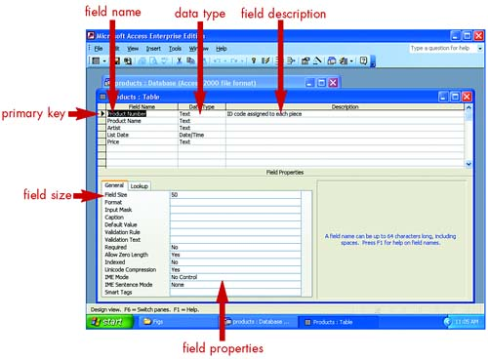
Creating Databases and Tables
To use Access, you start by creating a database. Within that database, you can then create tables, forms, reports, and other Access objects that help you organize your data. To help you quickly and easily create a database, Access 2003 includes several database templates, including the Asset Tracking, Event Management, and Time and Billing databases, to name a few.

Slide 13
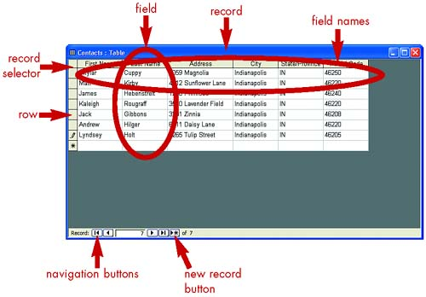
Entering Data (MS Access)
In Access, a table is divided into fields, and each field contains one piece of information such as a last name or a price. One completed set of fields is a record. This part covers how to enter data into a database table, creating the records for your database table. You also learn how to work with the records, edit data, sort records, print data, and so on.

Slide 14
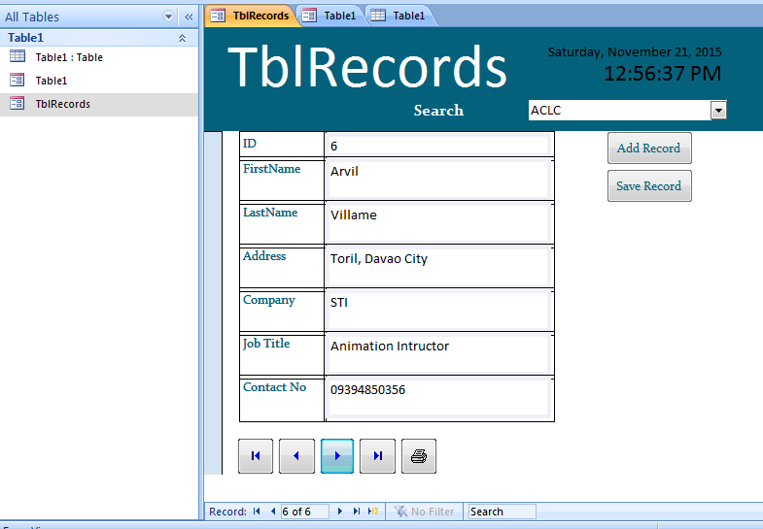
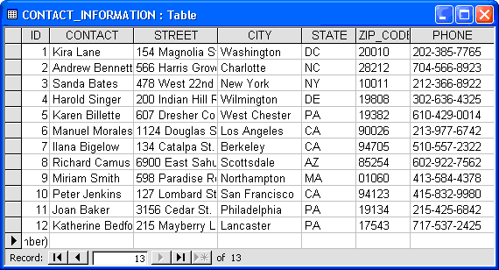
Front-End and Back-End Database
The Front-End, is everything involved with what the user sees, including design and some languages like HTML and OOP.
The Back-End, or the “server-side”, is basically how the site works, updates and changes. This refers to everything the user can’t see in the browser, like databases.
Front-End
using Access Form
Back-End
Database
MS Access
SQL
NotePad
Excel

Slide 15
What are the Microsoft Access advantages?
Easy to install and use — Access gives data managers a fully functional, relational database management system in minutes.
Ease to integrate – Access works well with many of the developing software programs based in Windows. It also can be used in the front-end as back-end tables with products like Microsoft SQL Server.
Widely popular — Microsoft Access is the most popular desktop database system in the world.
Importing data — Microsoft Access makes it easy to import data.
Convenient storage capacity – A Microsoft Access database can hold up to 2 GB of data.
Saves you money — Microsoft Access is hundreds of dollars more economical than other larger systems; offering the same functions and usage.

